Slide 1

EXISITNG OPERATING RULES OF MAJOR DAMS BUILT INTO WATER RESOURCES YIELD MODEL FOR THE LETABA RIVER SYSTEM
31 October 2013
INFORMATION WORK SESSION
Presented by:
Pieter van Rooyen

Slide 2
Major Dams focussed on
Dap Naude
Ebenezer
Magoebaskloof & Vergelegin
Hans Merensky
Tzaneen
Thabina
Middel Letaba
Nsami
Modjaji

Slide 3
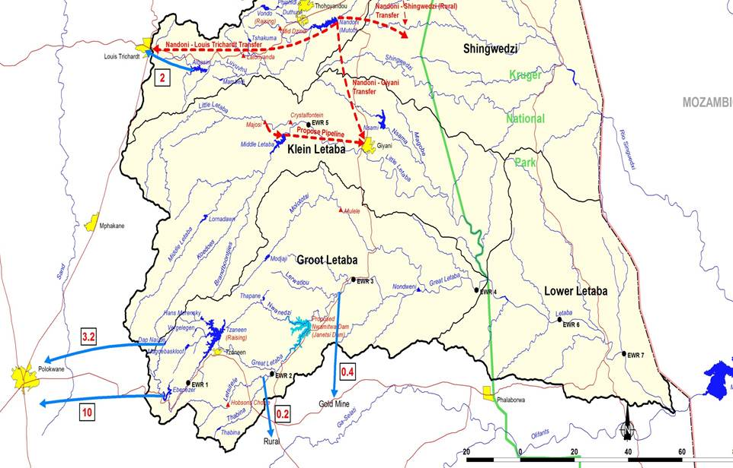
Location of Dams on Map

Slide 4
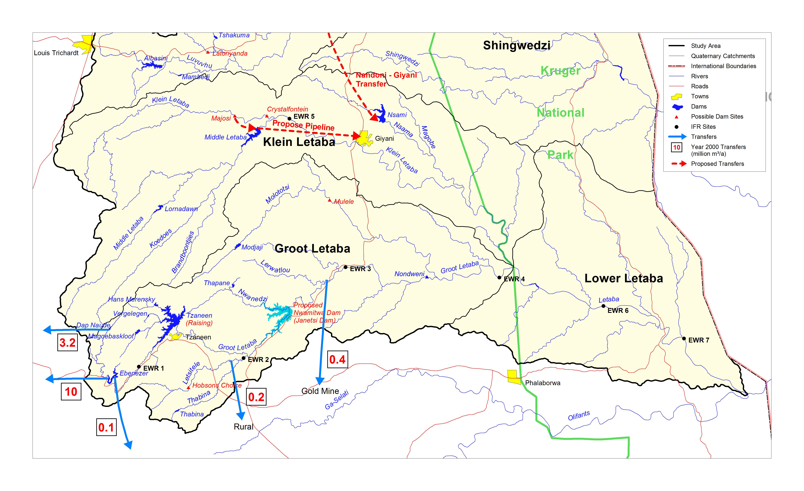
Location of Dams on Map

Slide 5
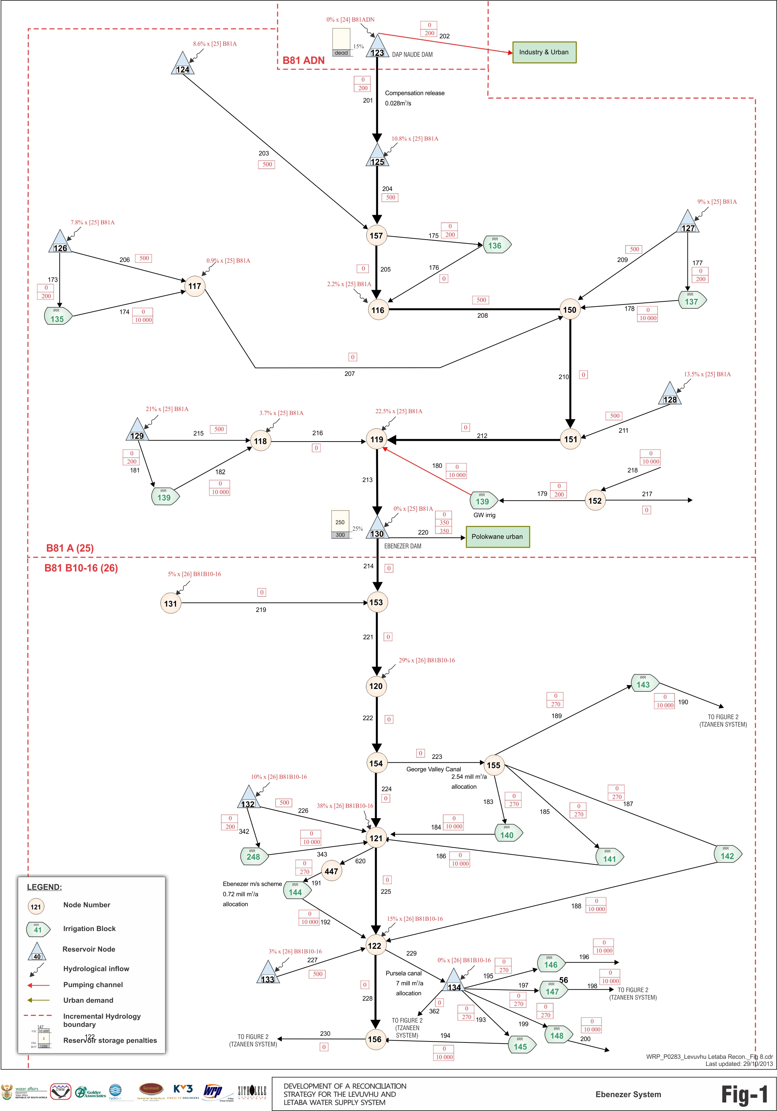
Location of Dams on schematic diagram:
Upper Letaba 1
Dap Naude
Ebenezer
Georges Valley Canal
Pusela Canal

Slide 6
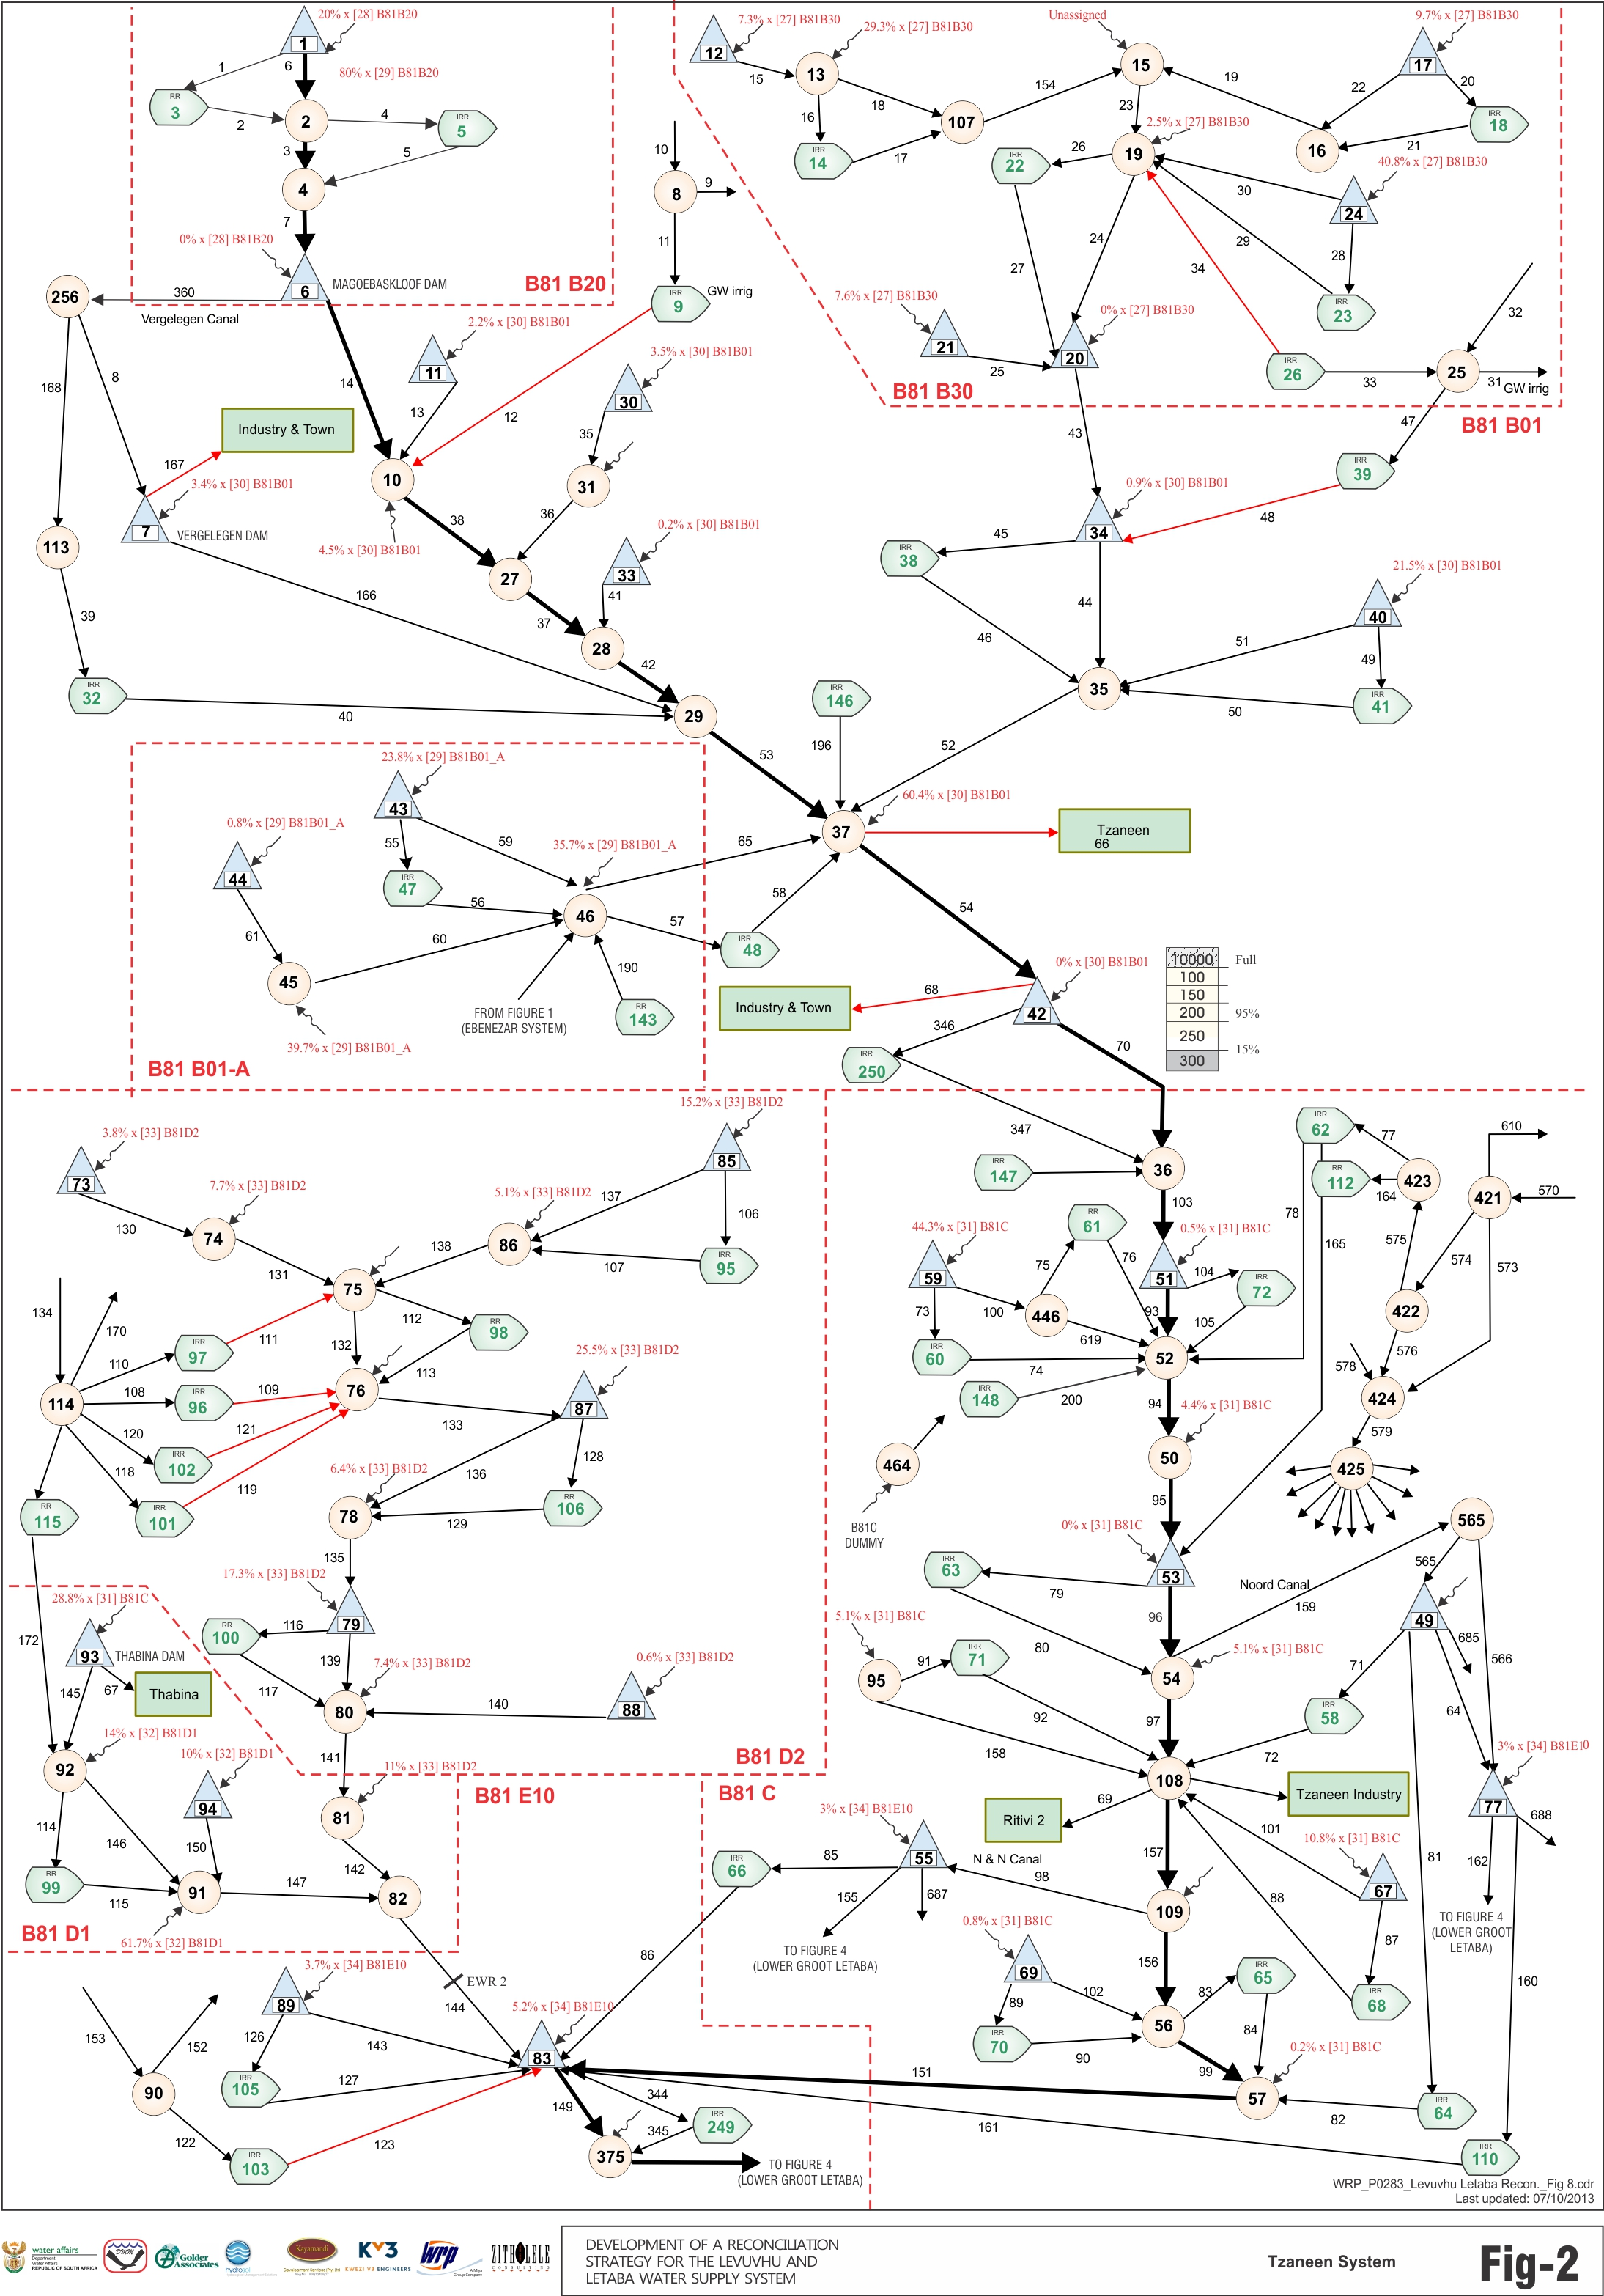
Magoebaskloof
Location of Dams
on schematic diagram:
Upper Letaba 2
Vergelegin
Hans Merensky
Tzaneen
Thabina
Noord Canal
NN Canal

Slide 7
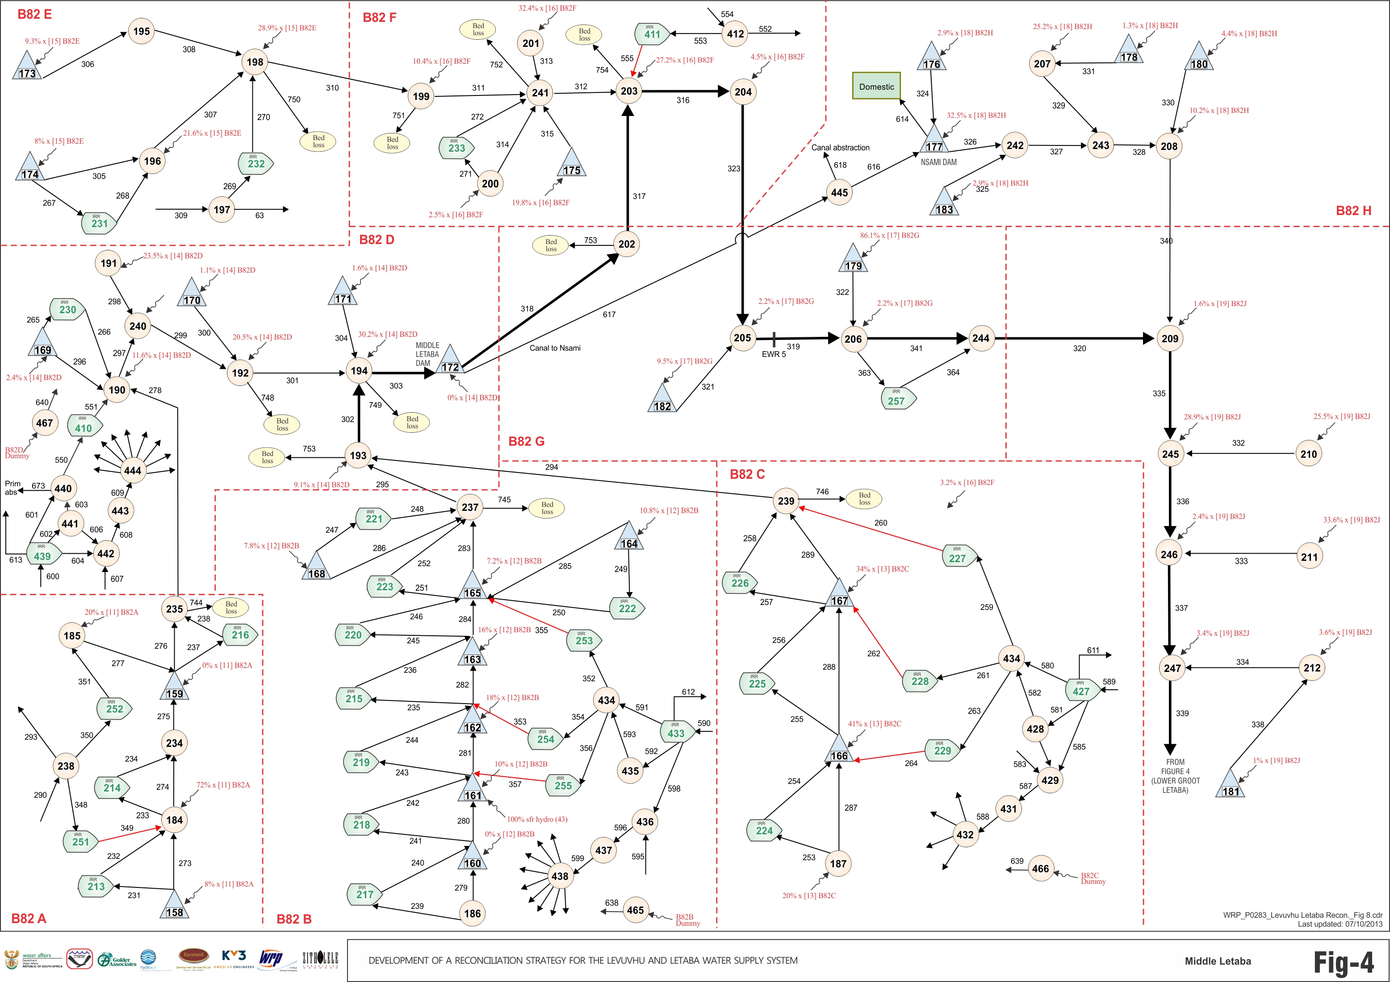
Location of Dams on schematic diagram: Middle Letaba
Nsami
Canal
Middel Letaba

Slide 8
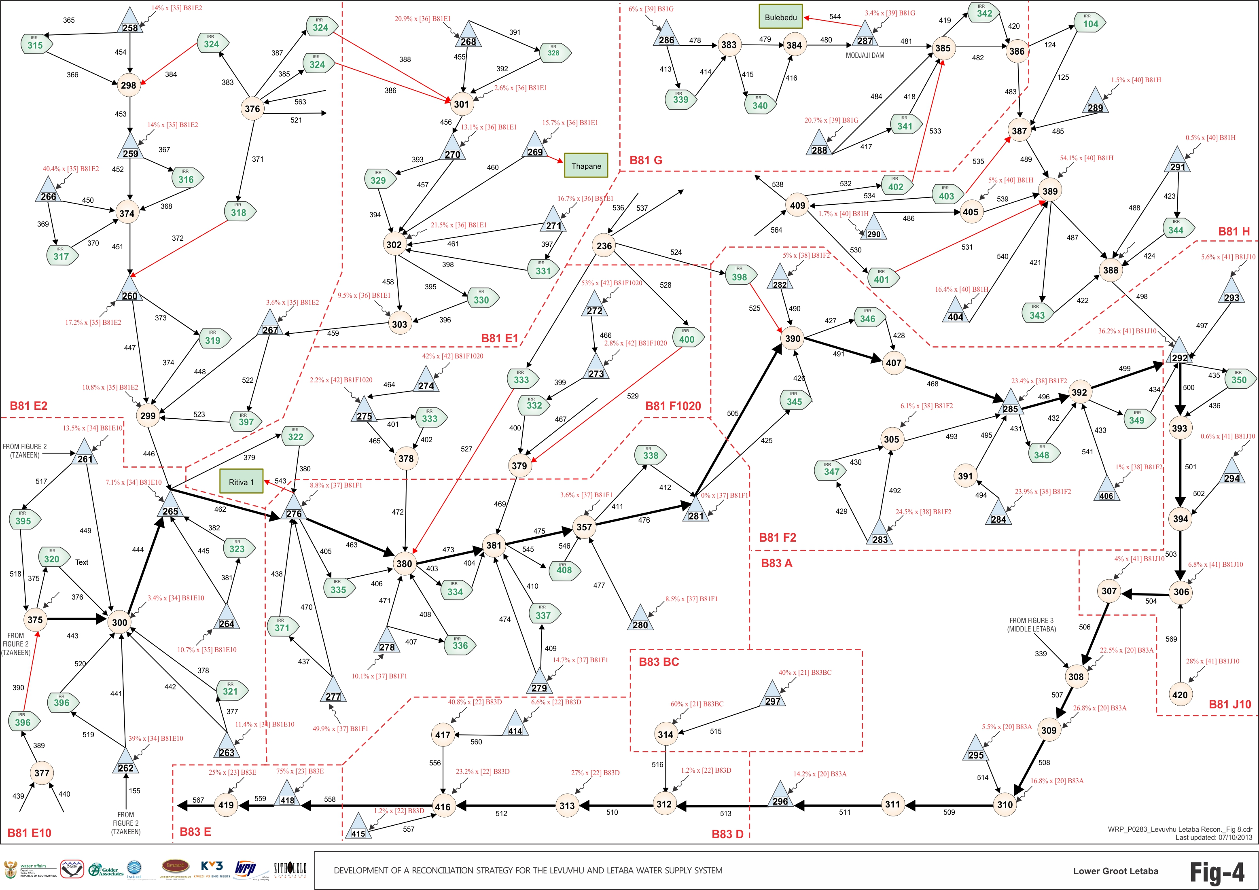
Location of Dams on schematic diagram: Lower Groot Letaba
Modjaji

Slide 9
DAP NAUDE
Current court order: 0.028 m³/s released from November to June, with the full inflow to the dam being released in August, September & October
Present day simulated 0.028 m³/s all year round
No support to Ebenezer
Current abstraction: Polokwane: 4.07 mill m³/a (gauge: B8R006)
Present Day simulated
Court order

Slide 10
EBENEZER
Rule: no support to Tzaneen BUT reality shows different
2 release events from Ebenezer when
Tzaneen Dam low

Slide 11
EBENEZER
To simulate closer to observed, built in rule to support Tzaneen when Tzaneen drops below 15%
No support to Tzaneen
Tzaneen
Ebenezer
With support to Tzaneen
Tzaneen
Ebenezer

Slide 12
EBENEZER DEMANDS & RESTRICTIONS
Directly from dam: Polokwane: 16.2 million m³/a (Gauge B8R001)
Irrigation:
    Releases for Georges Valley Canal: 2.54 million m³/a
    Releases for Pusela Canal: 7.00 million m³/a
    Releases for Main stem: 1.85 million m³/a
    Total: 11.4 million m³/a
Irrigators restricted based on Tzaneen Dam operating rule and levels AND 0 allocation when Ebenezer < 20%
Urban 70% allocation when Ebenezer < 20%

Slide 13
MAGOEBASKLOOF & VERGELEGIN
Measured canal outflow from Magoebaskloof, 4.6 million m³/a (gauge: B8R003)
Irrigation for tea plantation greatly reduced from allocation for present day run
Abstraction from Vergelegin for Industry and town = 2.16 million m³/a, given priority
Magoebaskloof
Vergelegin

Slide 14
HANS MERENSKY
No support to Tzaneen
Only irrigation demand from dam, 4.5 million m³/a

Slide 15
TZANEEN DEMANDS AND RULE
Rule: below 95% irrigators cut to 50% allocation, reviewed incrementally as dam recovers above 95%
Below 15% irrigators get 0%, urban cut to 70%
Irrigation:
    Noord Kanaal: 28.8 million m³/a
    N&N Kanaal: 13.03 million m³/a
    Main River Tzaneen: 27.85 million m³/a
    Total: 69.68 million m³/a
0.6 m³/s must pass Letaba Ranch, released from Tzaneen when incremental insufficient
Urban demands: Tzaneen town, Ritivi 1 & 2, Ba Phalaborwa: 12.4 million m³/a

Slide 16
Tzaneen Dam simulated
With restriction rule
No restriction rule

Slide 17
MIDDEL LETABA
Releases through canal to Nsami Dam as per measurements (gauge B8R007) 18.3 million m³/a
Abstraction and losses from canal calculated from measurements (gauge B8R007 - B8H067): 16.8 million m³/a
Urban abstraction from dam: 2.7 million m³/a

Slide 18
NSAMI
Urban abstraction from dam: 2.8 million m³/a

Slide 19
MODJADJI
Urban abstraction from dam: 2.9 million m³/a

Slide 20
THABINA
Urban abstraction from dam: 2.8 million m³/a

